Slide 1

Extending the Use of Metformin
Richard Day
Clinical Pharmacology & Toxicology
Clinical Pharmacology & Toxicology

Slide 2
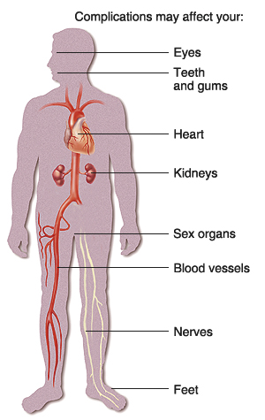

Type 2 diabetes mellitus (T2DM)
382 million people worldwide in 2013
592 million by 2035 (UN, 2013)
Hyperglycaemia - insulin resistance and ↓insulin secretion
Complications: vasculopathy, retinopathy,
and nephropathy
7 classes of oral anti-diabetic drugs
Notes:
Treatment of T2DM has advanced over the last decade, there are currently over 7 drug classes available.
However, although the treatment options are increasing, the incidence of T2DM is also increasing.

Slide 3
Metformin – Dimethylbiguanide
Gallega Officinalis
(French Lilac)
1929 - Several biguanidines synthesised¹.
Introduction of insulin → declining interest in biguanidines until 1950’s.
1959 - Phenformin associated with fatal lactic acid acidosis; not observed with metformin.
1977 - Phenformin & Buformin withdrawn in USA then elsewhere.
Metformin suffered collateral damage.
1) Hesse G, Taubmann G. Die Wirkung des Biguanids und seiner Derivate auf den Zuckerstoffwechsel. Naunyn- Schmiedebergs. Arch Exp Path Pharmacol 1929; 142: 290–308.
Notes:
The oral absorption, hepatic uptake and renal excretion of metformin are mediated very largely by organic cation transporters (OCTs).
An intron variant of OCT1 (single nucleotide polymorphism [SNP] rs622342) has been associated with a decreased effect on blood glucose in heterozygotes and a lack of effect of metformin on plasma glucose in homozygotes.
An intron variant of multidrug and toxin extrusion transporter [MATE1] (G>A, SNP rs2289669) has also been associated with a small increase in antihyperglycaemic effect of metformin.
Overall, the effect of structural variants of OCTs and other cation transporters on the pharmacokinetics of metformin appears small and the subsequent effects on clinical response are also limited.
However, inter-subject differences in the levels of expression of OCT1 and OCT3 in the liver are very large and may contribute more to the variations in the hepatic uptake and clinical effect of metformin.

Slide 4
Metformin – First line therapy for T2DM
Benefits:
  Little or no hypoglycaemia
  Little or no weight gain
  Evidence for ↓ risk microvascular and macrovascular complications
    Cardioprotective
  Possible ↓ Risk of cancer

Slide 5
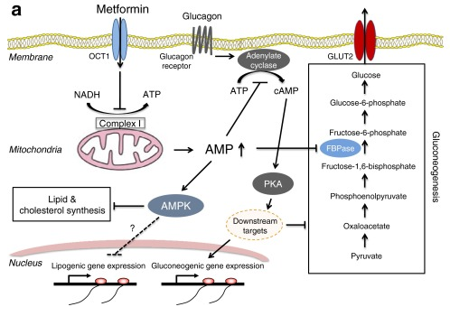
Metformin - Mechanism of Action
Rena et al, Diabetologia 2013, 56:1898
Notes:
Metformin lnhibits Complex 1- mechanism unknown-producing a deficit in energy production leading to reduced energy consumption by the cell and reduced gluconeogenesis in the liver
Inhibition of gluconeogenesis is via a) increased AMP and decreased ATP, this ratio directly inhibiting gluconeogenesis due to energy deficit and lower ATP and b) raised AMP acts as key signalling mediator inhibiting cAMP-PKA signalling via suppressing adenylate cyclase AND inhibiting FBPase (Fructose-1,6-biphosphate) (key gluconeogenisis enzyme) AND activates AMPK.
All of this leads to inhibition of gluconeogenesis and lipid/cholesterol synthesis

Slide 6
Metformin-Associated Lactic Acidosis (MALA)
Biguanides linked to lactic acidosis
  Phenformin (40-64 cases/100,000 patient-years)
  Metformin (0-16 cases/100,000 patient-years)
Contraindication – chronic kidney disease. Heart failure, severe hepatic insufficiency
  Not based on trial evidence
‘Decreasing’ adherence to guidelines
Guidelines | Renal function cut-off
Product Information | CL_{CR} <60 mL/min
Aust. Medicines Handbook | CL_{CR} <30 mL/min
UK N.I.C.E. | eGFR <30 mL/min/1.73m²
FDA | Creatinine > 1.4 mg/dl (124 μmol/L)
Duong, J. K.; Furlong, T. J.; Roberts, D. M et al. Drug Saf. 2013;36(9):733-46. Epub 2013/04/03
Notes:
FDA registered metformin 1996
Metformin does not lactate

Slide 7
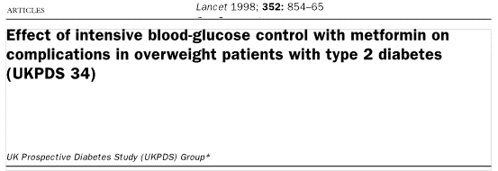
UK Prospective Diabetes Study (UKPDS)
  20 year study (1978-1998)
  23 centres; 4,075 patients (1704 patients > 120% ideal BMI)
Conventional therapy vs intensive pharmacological therapy
  Insulin, sulphonylurea or metformin
Cardiovascular disease accounted for 62% of the total mortality in the overweight patients in the conventional treatment group.
The metformin group had:
  36% lower risk (p=0·011) of all-cause mortality,
  39% lower risk (p=0·010) of myocardial infarction,
  30% lower risk (p=0·020) of macrovascular disease (myocardial infarction, sudden death, angina, stroke, and peripheral disease), than the conventional group.

Slide 9
Design: 304 patients, mean age = 63 yr, randomised to glipizide (30 mg daily) or metformin (1.5 g daily) for 3 years. [5 yr follow-up].
End points: Times to composite of recurrent cardiovascular events [death from CV or any cause; MI; stroke; arterial re-vascularisation].
Findings: Metformin reduced major cardiovascular events at median of 5.0 years compared with glipizide.
Results indicated a potential benefit of metformin therapy on cardiovascular outcomes in high-risk patients.
Diabetes Care 2013; 36:1304-1311

Slide 10
Conclusions— “The totality of evidence indicates that metformin is at least as safe as other glucose-lowering treatments in patients with diabetes mellitus and HF and even in those with reduced left ventricular ejection fraction or concomitant chronic kidney disease. Until trial data become available, metformin should be considered the treatment of choice for patients with diabetes mellitus and HF”.

Slide 11
Our Metformin Studies
PK of Metformin
CL_{R} and effect of SNPs
MALA: Model for Pathogenesis
National & SVH Usage
PK & Safety in Patients with CKD
PK in Indigenous T2DM patients
Safety & PK in other contraindications:
Liver Disease
Heart Failure
PK & Safety in Patients on Haemodialysis
Notes:
Light blue – focus of this talk

Slide 12

Pharmacokinetics (PK) of metformin
Hydrophillic base, cationic (>99.9%) @ pH 7.4
Not metabolised, eliminated unchanged,
Renal clearance (CL_{R}) ≈ 4x creatinine clearance (CL_{CR})
Bioavailability (F): 25 – 75 % with average of 55%
Half-life (t_{1/2}): 5 - 6 hours (longer terminal half-life)
Volume of distribution (V_{D}/F): 600-800 L
Graham et al, Clinical Pharmacokinetics 2011; 50(2):1-18
Notes:
Large variability in PK.
The PK characteristics of metformin suggests that its uptake is largely mediated by active transporters and may be a source of the large BSV.
Documented transporters of metformin include the OCT1, OCT2 and OCT3, MATE1 and MATE2K, and PMAT.
Peak plasma concentrations of metformin occur approximately 3 hours after dosage. The peak plasma concentrations range from 1.0 to 1.6 mg/L after a 0.5 g dose, increasing to about 3mg/L after a 1.5 g dose. The plasma concentrations decrease rapidly after a single oral dose and, as is the case after intravenous dosage, the rate of urinary excretion can be followed for a longer time than the plasma concentrations and again indicates a terminal t1/2 of about 20 hours.
Metformin is also taken up by erythrocytes from which the t1/2 of loss is also about 20 hours
Absorption from the stomach is likely to be negligible and it therefore appears that the absorption of metformin is confined very largely to the small intestine with negligible absorption also from the large intestine.

Slide 13
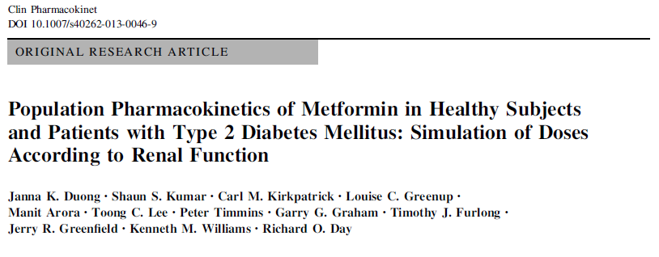

Slide 14
Methods - Datasets
Study | Subjects | Doses | Blood sampling
A | 120 T2DM patients (at steady-state) | IR, XR | 1. Sparse (1-6 bloods per patient) 2. Intensive (n=16; 8-10 samples in dosage interval (12h or 24h)
B* | 16 Caucasians (at steady-state) | IR and XR, dose-escalation | Intensive blood sampling (5 occasions) over 6 weeks
C | 169 Malaysians (single dose) | IR | Intensive sampling (14 samples in 14 hours)
IR, immediate-release
XR, extended-release
*Timmins et al., Clin Pharmacokinet 2005

Slide 15
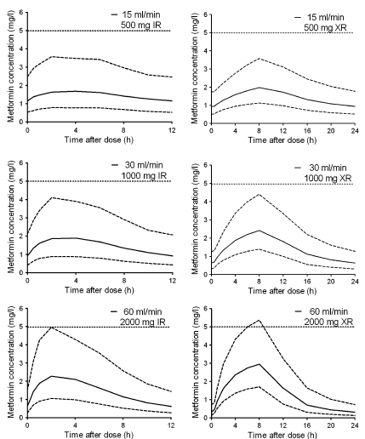
Dosing simulations
Maximum daily metformin doses. Metformin C_{P} at 5th, 50th, 95th percentiles
Metformin plasma concentration (C_{P}) of 5 mg/L used as upper limit (Lalau et al., 1999)
Suggested daily doses for:
  15 mL/min is 500 mg
  30 mL/min is 1000 mg
  60 mL/min is 2000 mg
  > 90 mL/min is 3000 mg
Notes:
SNPs were not significant covariates on metformin CL/F or CL_{R}
Creatinine clearance (C&G using lean body mass) explained 28% of the variability in metformin CL/F.
Total body weight explained 27% of the variability in metformin Vd/F.
33.3 * egfr

Slide 16
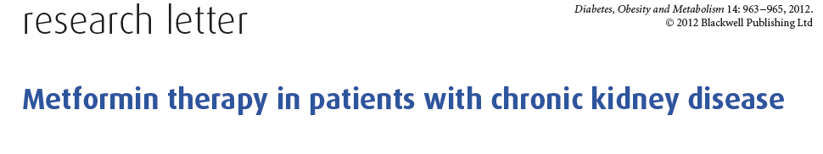
J. K. Duong, D.M. Roberts, T. J. Furlong, S.S.,Kumar, J. R.Greenfield, C.M. Kirkpatrick, G.G. Graham, K.M.Williams & R.O.Day

Slide 17

Metformin Safety in CKD
Methods
Patients with CKD currently taking metformin (n=22; creatinine clearances 15–40 ml/min) were:
Ceased metformin
Then prescribed low doses of metformin (500 mg daily) for 6 weeks
Blood samples for metformin, lactate & creatinine
Duong et al, Metformin . Diabetes, Obesity & Metabolism 2012; 14:963

Slide 18
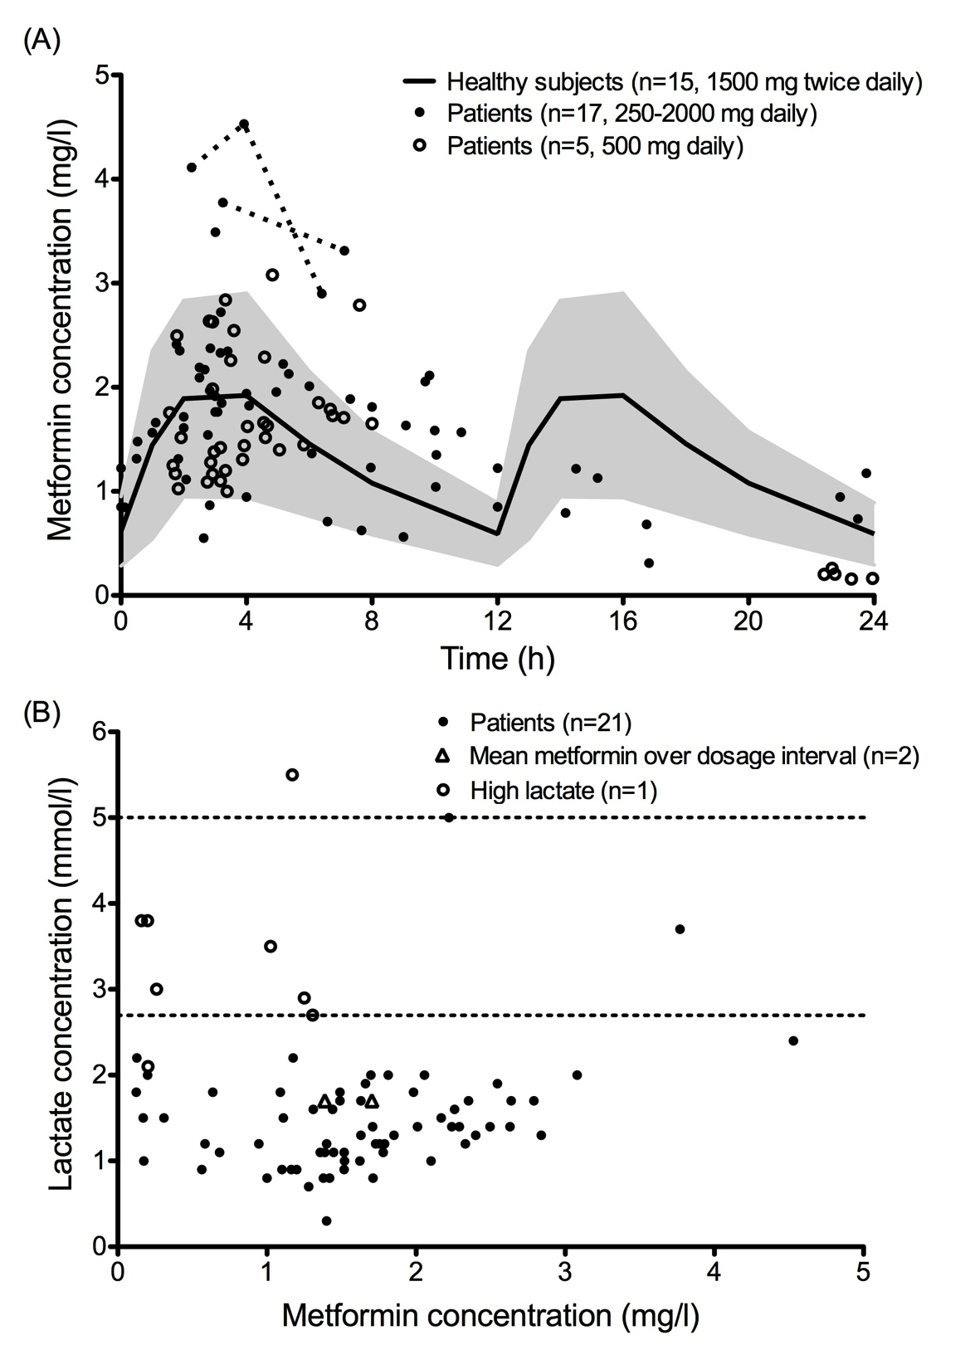
Metformin concentrations within normal range
Duong et al, Metformin. Diabetes, Obesity & Metabolism 2012; 14:963
Notes:
Metformin concentrations in healthy subjects (n=15, Timmins et al.) were scaled to 1500 mg twice daily
Data are shown as mean and 95% confidence interval (shaded area).
Excluding dialysis patients, metformin concentrations were compared with patients on range of doses (n=17), and a subset of patients on low metformin doses (n=5).
Patients with high metformin concentrations are shown with connecting dotted lines (n=2).

Slide 19
No correlations between metformin & lactate concentrations
Duong et al, Metformin . Diabetes, Obesity & Metabolism 2012; 14:963
Notes:
Open-label observational study investigating metformin and lactate concentrations in patients with CKD (n=22; creatinine clearances 15–40 ml/min) & in two dialysed patients (1HD;1PD).
Patients were prescribed a range of metformin doses by their physicians (250–2000 mg daily)
Metformin concentrations compared with data from healthy subjects (scaled to 1500 mg twice daily).
A subset of patients (n=7) was controlled on low doses of metformin (250 [HD patients] or 500 mg daily).
Patients followed for 6 weeks
No correlation between metformin and lactate concentrations was observed.

Slide 20
Metformin Safety in CKD
Metformin can be safely used in patients with CKD
Daily doses should be lower
Large variability in concentrations!
  likely due to variable absorption
Metformin & lactate concentrations should be monitored regularly
Duong et al, Metformin. Diabetes, Obesity & Metabolism 2012; 14:963
Notes:
Patients with ESRF likely to have both macrovascular and microvascular complications

Slide 21
Metformin in Diabetic Haemodialysis Patients
Methods
Patients (n = 4) with T2DM + ESKD who were:
  Metformin naïve
  Undergoing regular haemodiafiltration (HDF)
  3 sessions/week
  Prescribed metformin (IR) for 12 weeks
    500 mg post-HDF (i.e. 1500 mg/week)
Smith et al Am J Kidney Dis. 2016;68(6):990-992
4

Slide 22
Methods: Study Design & Sampling
All Study Visits:
  Occurred during the patient’s regular HDF sessions
  Pre-dialysis blood sample → biochemical monitoring
1
5
6
2
3
4
Screening
1st dose of metformin post-HDF
Blood samples collected during HDF to measure metformin extraction
Safety Monitoring:
  Metformin Plasma Concentrations ≤ 5 mg/L
  Lactate Concentrations ≤ 5 mmol/L
  Dose reductions made if these limits were approached
Week 1
Week 2
Week 3
Week 4
Week 8
Week 12
Blood samples collected between HDF sessions to measure peak metformin concentrations
5

Slide 23
Results: Baseline Demographics
 | Patient 1 | Patient 2 | Patient 3 | Patient 4
Age (years) | 60 | 67 | 80 | 69
Sex | M | M | M | M
Ideal Body Weight (kg) | 138.5 | 118.5 | 53.0 | 88.0
BMI (kg/m²) | 45.7 | 34.6 | 21.8 | 29.4
Serum Creatinine (μmol/L) [normal range: 60-120 μmol/L] | 919 | 695 | 748 | 696
Creatinine Clearance (mL/min) | 8.3 | 10.0 | 4.3 | 7.8
6

Slide 24
Results:
Safety
Dose Reduction
13

Slide 25
Metformin Dialysis Study II
Protocol
Progress at Cessation
Longitudinal study (CTN) of diabetic patients in dialysis taking metformin 250 mg post each dialysis session
Metformin & lactate concentration monitored pre-dialysis
Proposed 50 subjects at SVH and Liverpool dialysis centres
8 patients entered
Patient 1, aged 63, died ~ 45 minutes post dialysis
  Been on metformin since first study
  Pre-dialysis metformin 2.2 mg/L; lactate 0.8 mmol/L (4 days prior)
  Cardiac arrest*, unspecified
Patient 2, aged 64, died at home post dialysis#
  2 weeks on metformin
  Pre-dialysis metformin 1.1 mg/L; lactate 2.7 mmol/L (7 days prior)
  Presumed MI (coroner’s verdict)
* MI with ventricular fibrillation
#Unknown time of death - awaiting autopsy. Died at home over weekend. Last dialysis session Friday; did not turn up for dialysis Monday morning; TOE & cardioversion for arrhythmia 1 week prior to death
Notes:
A patient had agreed to participating but had an MI and died prior to commencing

Slide 26
Conclusions
Safe use of metformin in HDF patients still worth pursuing
  Diabetes control and cardiovascular risk reduction
Monitoring for metformin and lactate concentrations needed
Is there an ‘interaction’ between metformin & dialysis patients ‘increasing’ cardiovascular risk?
Approach to answering this question under consideration
Ethical aspects also under consideration

Slide 27
Acknowledgements
ILP Students
Manit Arora, 2009
Ji Moon, 2013
Hannah Braithwaite, 2014
Suraj Gangaram, 2015
BSc Hons Students
Suraj Gangaram, 2014
Janna Duong, 2009
Shaun Kumar, 2010
PhD Students
Janna Duong, 2010 - 13
Shaun Kumar, 2012-2015
Felicity Smith, 2014-
International Students
  Jeroen Punt, Holland, 2008
Anna Lindstrom, Sweden, 2009
Marjolein Kroonen, Holland, 2011
Clinical Pharmacology
Professor Garry Graham, Dr Sophie Stocker, Dr Jane Carland, Professor Ken Williams
Registrars
Dr Darren Roberts
Dr Jonathan Brett
Collaborators
Dr Tim Furlong & Dialysis Unit Nurses
A/Prof Jerry Greenfield
A/Prof Mark Danta
External Collaborators
  Professor Carl Kirkpatrick, Monash U
  Professor Susan Davis, Monash U
  Professor Kathy Giacomini, UCSF
  Dr Peter Timmins, UK
  Dr Tung Lee, Malaysia
  Dr Hiddo Heerspink, Netherlands
Funding
St Vincent’s Clinic Foundation, 2009
ARC Linkage Grant , LP0990670
Diabetes Australia Research Trust, 2014
NH&MRC Programme Grants 1054146

